Slide 1


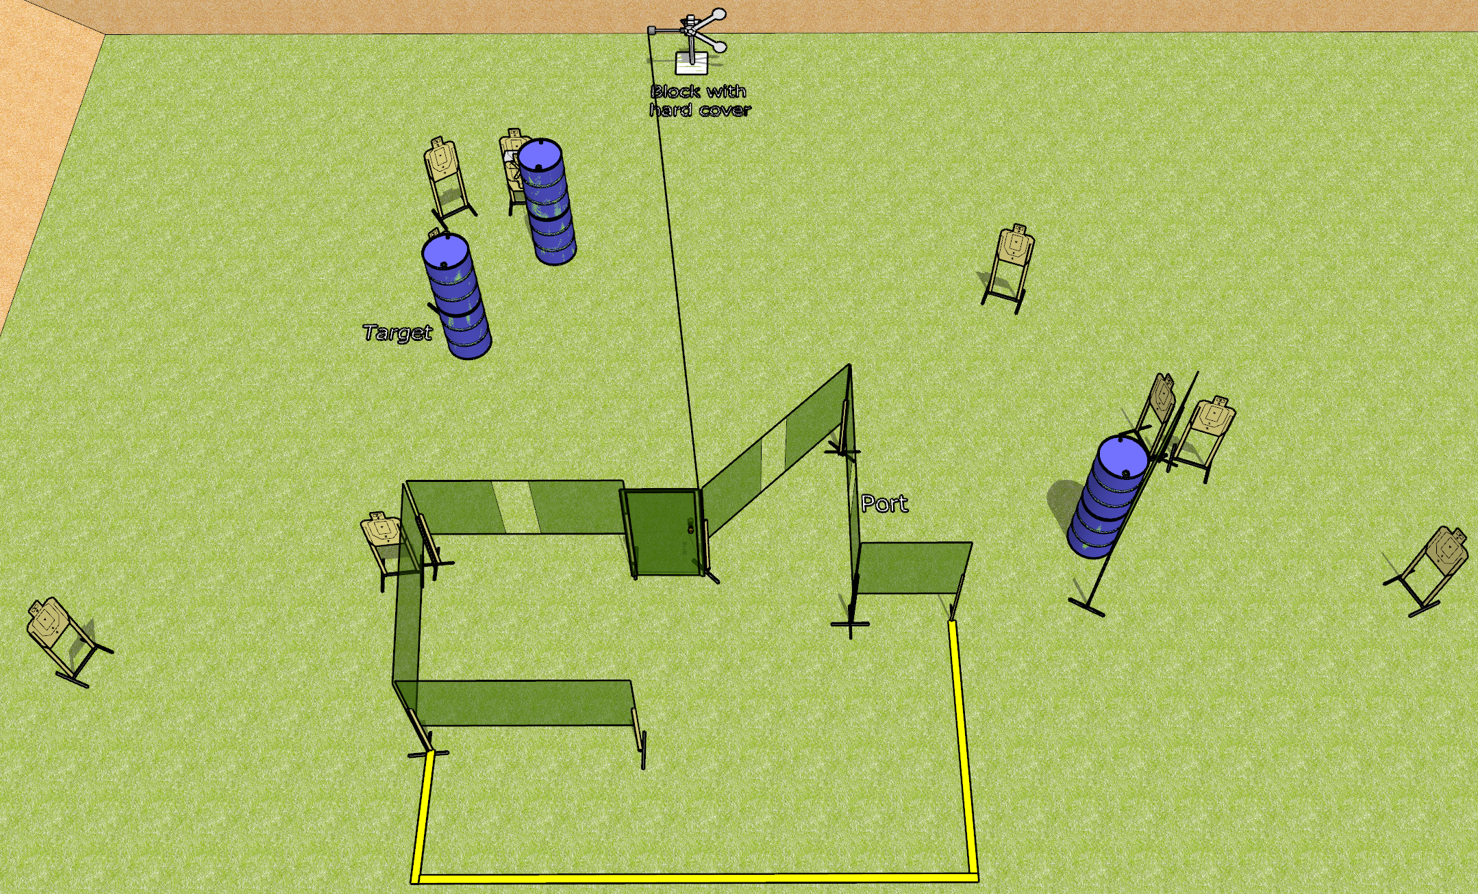
 | Dothan Gun Club – USPSA Match More Open Targets Course Designer : Drew Coleman
Round Count 22 rounds 10 USPSA 2 plates
Equipment List 11 wall feet 1 medium fault line Red stitch swinger + door + activator 11 targets (10 + 1NS)

Slide 2
More Open Targets
Written Stage Briefing
More Open Targets is a 22 round, Comstock course of fire. There are 10 USPSA targets and 2 falling plates. The best 2 hits on paper will score and steel must fall to score. The start signal is audible.
The swinger is activated by opening the door, and must be activated before being engaged.
Handgun start position is anywhere completely outside the shooting area, wrists below belt. Handgun is loaded and holstered.
PCC start position is anywhere completely outside the shooting area, stock on belt. Loaded carbine is held with both hands, safety on.
On start signal, engage targets as they become available from within the shooting area.

